Slide 1
Open Forum Agreements Region 3 and NCR
January 28, 2015

Slide 2
2015 Test Materials Forwarders
Testing Program | Forwarder
NAT G6 and Y4 | AIRSPEED
LAPG | FRONT CARGO

Slide 3
Allocation of Test Materials
NAT Y4 | 1:1 TB and AS
NAT G6 Schools with 3 rooms and below | 1:1 TB and AS
NAT G6 Schools with more than 90 enrolment | TB – 50% AS – 100%
LAPG | 1:1 TB and AS

Slide 4
Open Forum Agreements Regions 1, 2 and CAR
January 29, 2015

Slide 5
 | Where to Place
Form 5 | Box 1 of Test Booklets
Form 6 | Box 1 of Answer Sheets

Slide 6
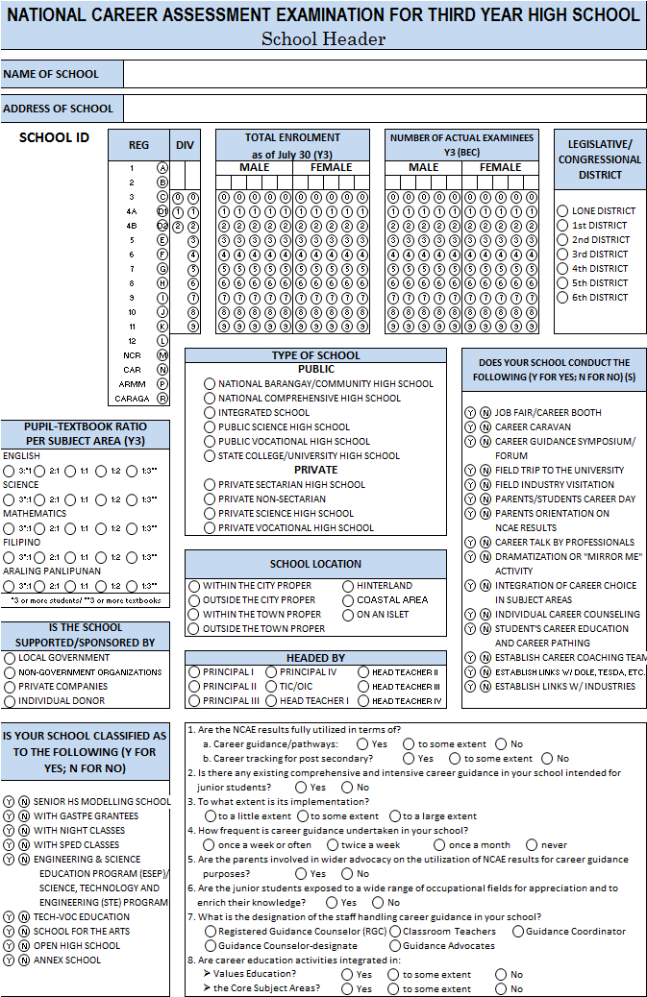
Discrepancy in the School ID (School Header vs. EBEIS)
1. Update the School ID
Cross out the temporary School ID
Write the EBEIS School ID below the bar code

Slide 7
Other Issues
Data requirements for PBB
Frequency and Percentage Distribution of Examinees/Schools based on performance in Quartile
NETRC will provide all data requirements to the Office of the Planning Service (Central Office) for the computation of the PBB so field personnel need not request from NETRC
Suggestion: Division Offices must be furnished a copy of whatever data are provided to the Region (e-copy)
Request for NAT Y4 COR as reference for the individual scores
Not needed since NETRC will already provide computed data to the Office of the Planning Service (Central Office) for this purpose

Slide 8
Open Forum Agreements Regions 6 and 7
February 3, 2015

Slide 9
Agreements
TB allocation for schools with more than 3 rooms | TB allocation will be rounded off to an even number

Slide 10
Email LAPG Enrolment Data to:
Test Administration Division (TAD), NETRC
Attention: Ms. Dely Servo
Chief, TAD
tad.netrc@yahoo.com

Slide 11
For queries / follow ups re Financial Concerns, please email:
acctg.netrc@gmail.com
Attention: Mr. Loreto Virgo, Jr.
Accounting Staff

Slide 12
Grades to be Provided in the Answer Sheet
LAPG (G3) | Final rating in the Third Quarter
NAT (G6) | Final rating in the Third Quarter
NAT (Y4) | Final rating in the Third Quarter
NCAE (G9) | Final Rating in G8

Slide 13
LAPG
Test Booklet 1 | Every pupil will answer this
Test Booklet 2 | Everybody will take this except for those pupils with Filipino/Tagalog Mother Tongue

Slide 14
Open Forum Agreements Regions 8, 10 and ARMM
February 4, 2015

Slide 15
Mother Tongue to be Tested in the LAPG
The Medium of Instruction (MOI) in the school and NOT the language of the community
If the Mother Tongue in your Division is not listed in the 19 Mother Tongues, then it will not be tested.

Slide 16
Request for English Proficiency Test for Teacher Applicants
Address the letter to:
Dr. Nelia Benito, Director III, NETRC
Send through email:
tad.netrc@yahoo.com
cc: depednetrc@yahoo.com
Or fax:
02-631-6921

